Slide 1
20 Book Challenge
"The more that you read, the more things you will know. The more you learn, the more places you'll go." — Dr. Seuss

Slide 2
20 - “you must be joking!”
I’m not!
30 students + 1 teacher reading 20 books = heaps of books, reading conversations, learning & better readers.

Slide 3
Our purpose
To read 20 books from a range of genres so that we learn more about what we like as readers and also what makes the genres different. We will learn how to make better choices when choosing books and how to talk to other people about books. Ruma Whitu students will learn to be more independent readers.

Slide 4
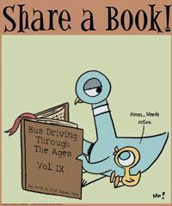
Reading Books
“You can find magic wherever
you look. Sit back and relax,
all you need is a book”
- Dr. Seuss

Slide 5
Success Criteria
We will read:
Realistic fiction: 2 Informational: 2 Fantasy: 1 New Zealand literature: 3 Poetry Anthologies: 1 Classic literature: 2 Historical fiction: 2 | Science fiction/Futuristic: 1 Biography, autobiography, memoir: 1 Collection of Short Stories: 1 Graphic Novel: 1 Mystery: 1 Free choice: 2

Slide 6
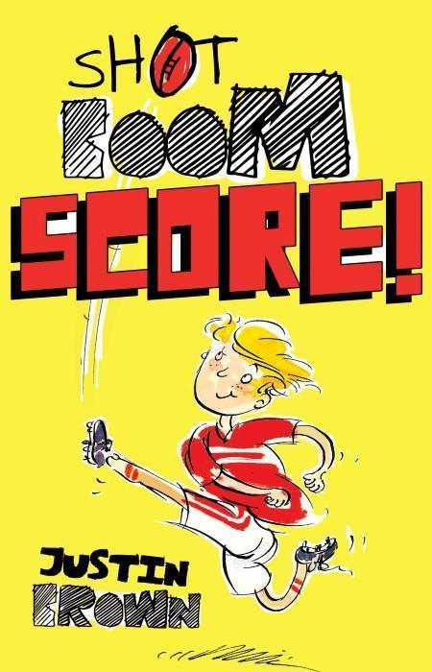
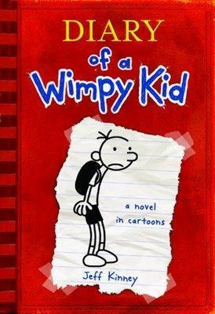
Introduction to Genres
What is Realistic Fiction?
Realistic fiction; a novel which is not true but could actually happen.

Slide 7
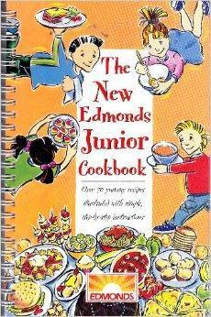
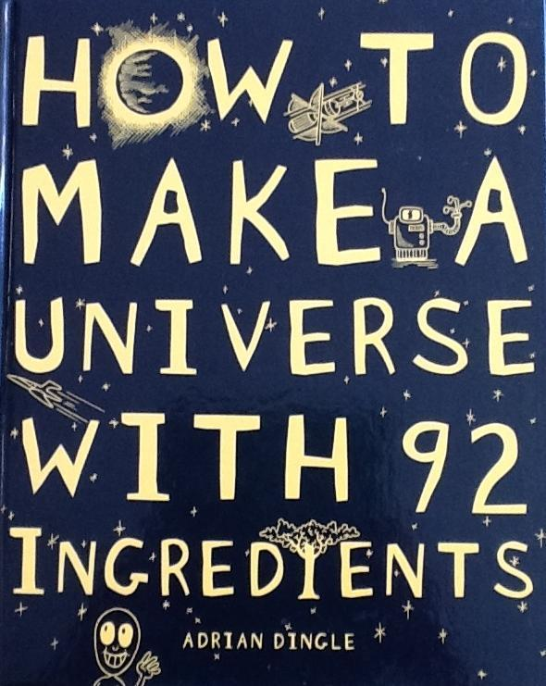
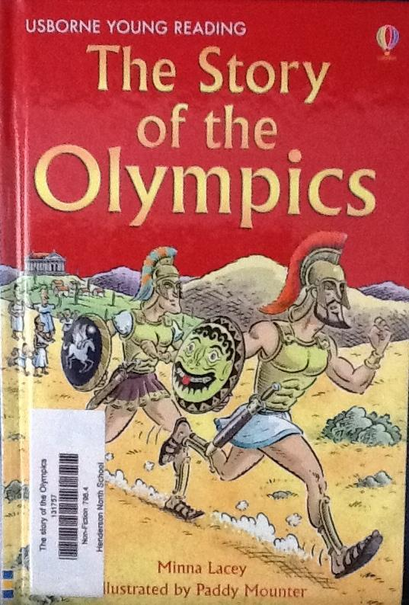
Informational
Informational texts convey information rather than tell a story.

Slide 8
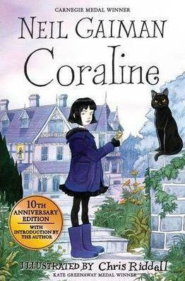
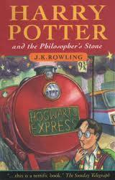
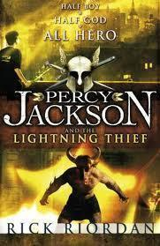
Fantasy
Fantasy novels feature imaginary worlds, extraordinary creatures such as talking animals, epic quests or magic.

Slide 9
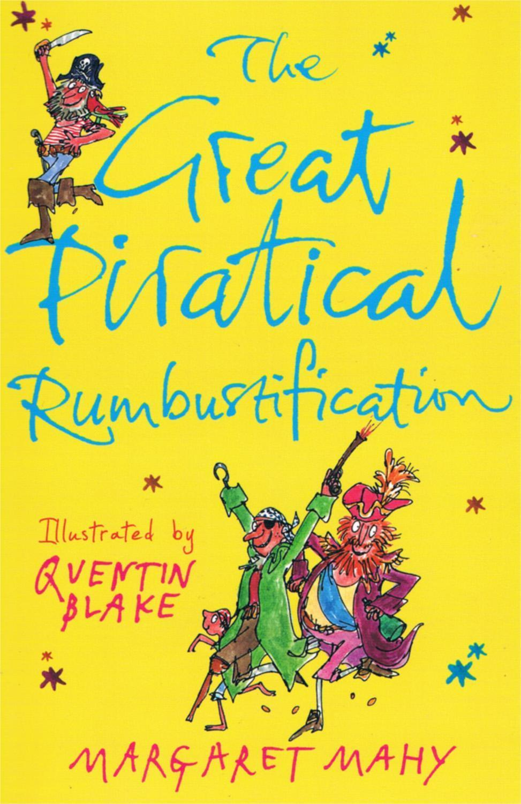
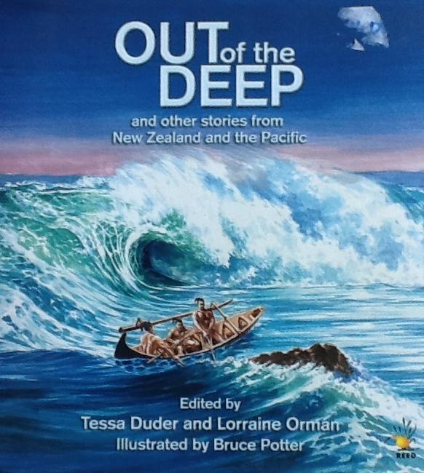
New Zealand Literature
NZ Literature is written by a New Zealand author and may include fiction or non-fiction.

Slide 10
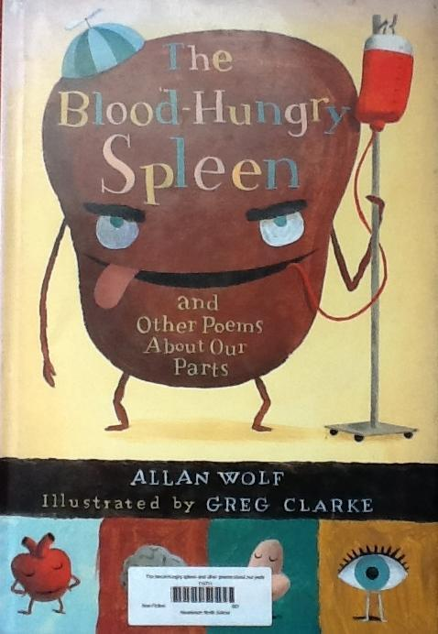
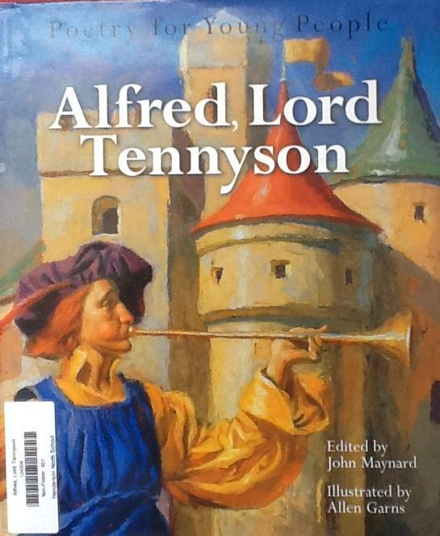
Poetry Anthologies
A poetry anthology is a collection of poems.

Slide 11
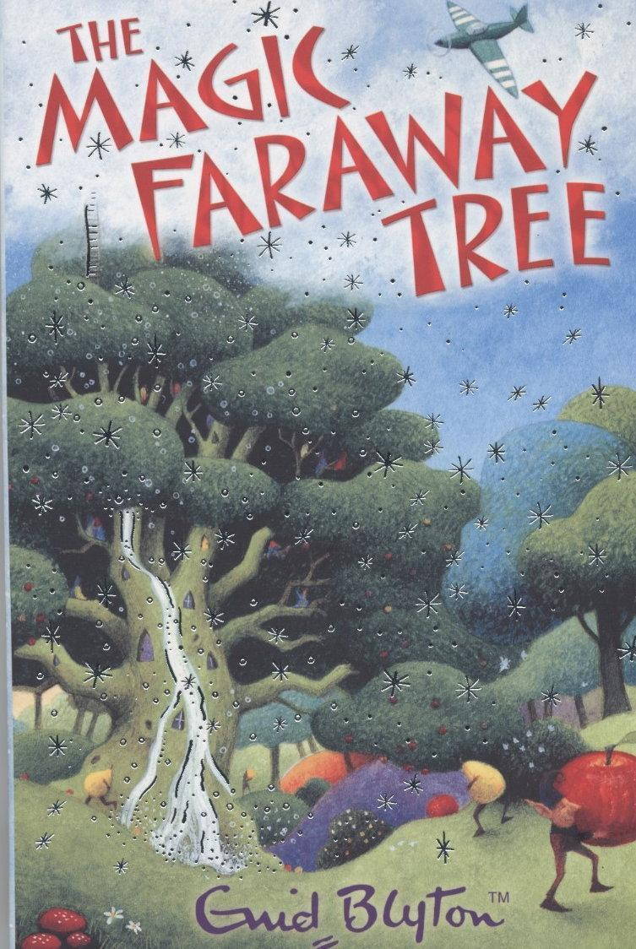
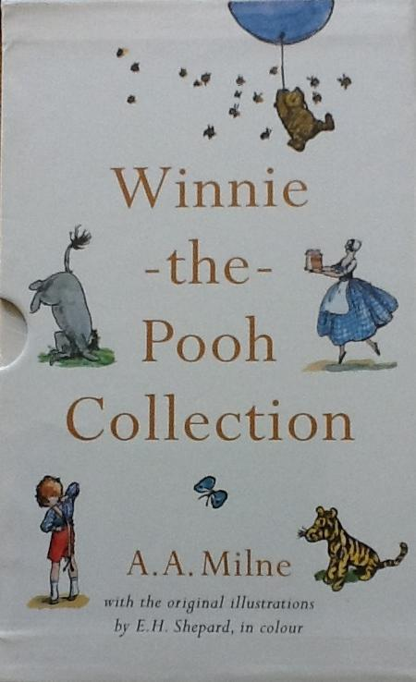
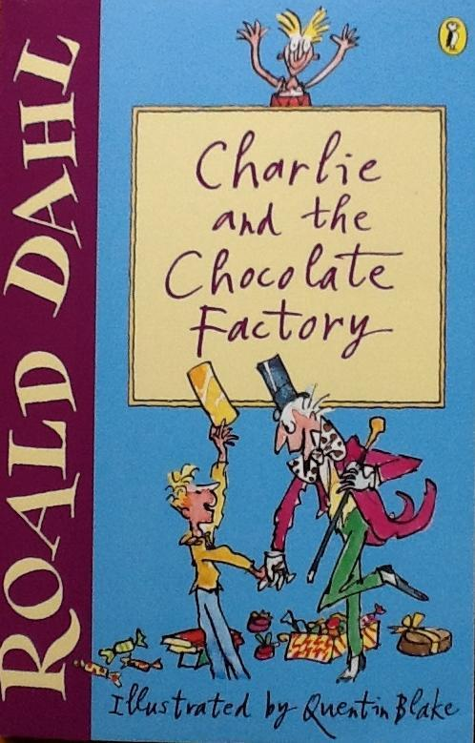
Classic Literature
Classic Literature includes books that are very well known and may have been handed down for a generation or more.

Slide 12
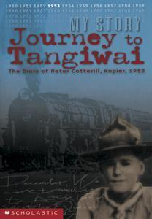
Historical Fiction
Historical Fiction tells a story that is set in the past. It may present actual events from the point of view of fictional characters.

Slide 13
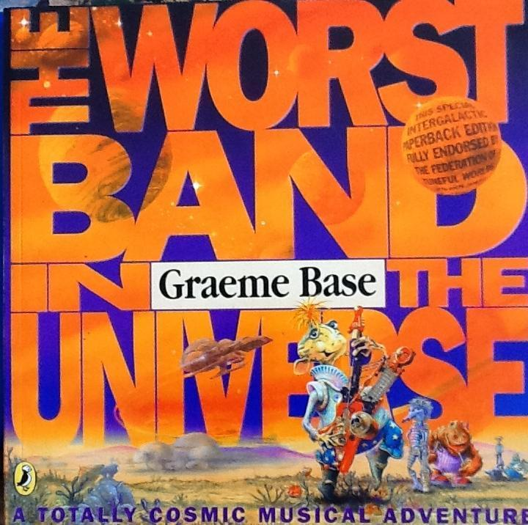
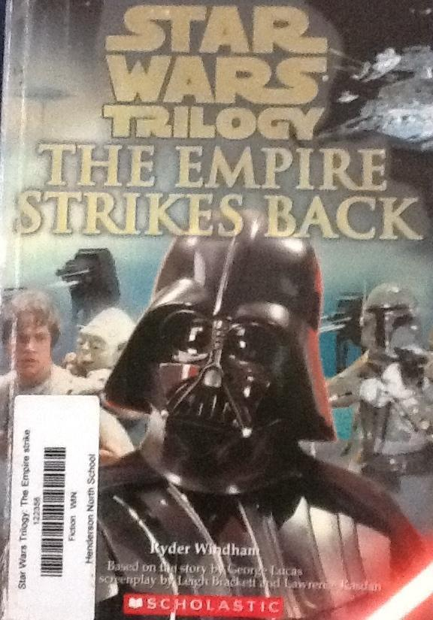
Science Fiction
Science Fiction stories often tell about the science and technology of the future. They are not completely unbelievable like fantasy novels.

Slide 14
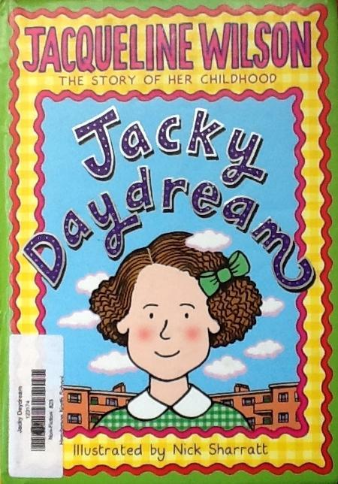
Biography/ Autobiography/ Memoir
Biography- An account of a person's life written by someone other than the person featured.
Autobiography- An account of a person's entire life told by the person featured.
Memoir- A portion of one's life as told by the person themselves

Slide 15
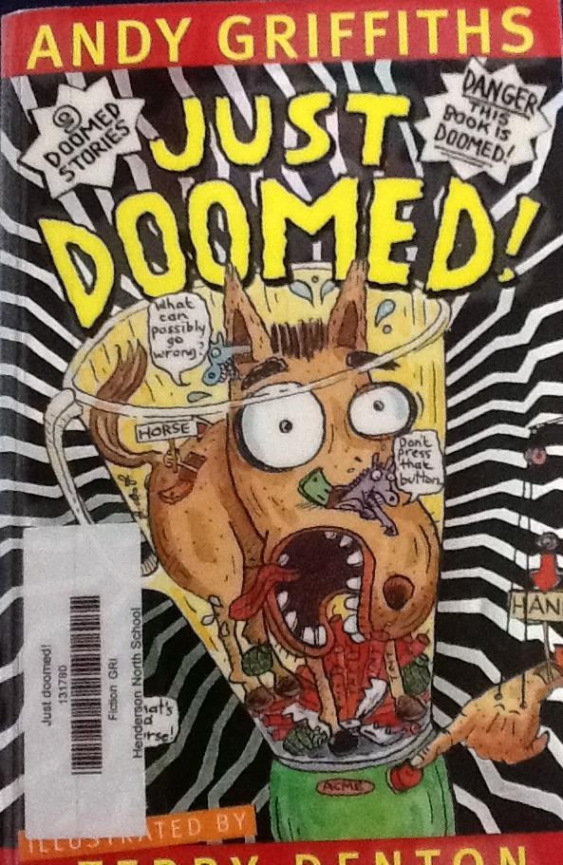
Short Stories Collection
A collection of short stories!

Slide 16
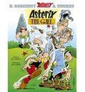
Graphic Novel
A graphic novel is a book written and illustrated in a comic strip format.

Slide 17
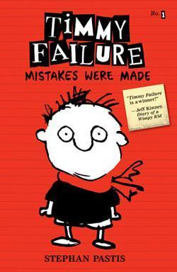
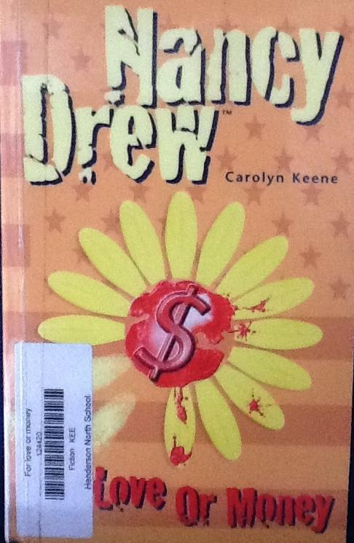
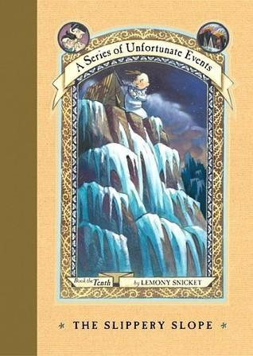
Mystery
A suspenseful story about a puzzling event that is not solved until the end.

Slide 18
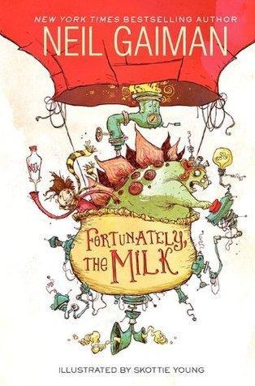
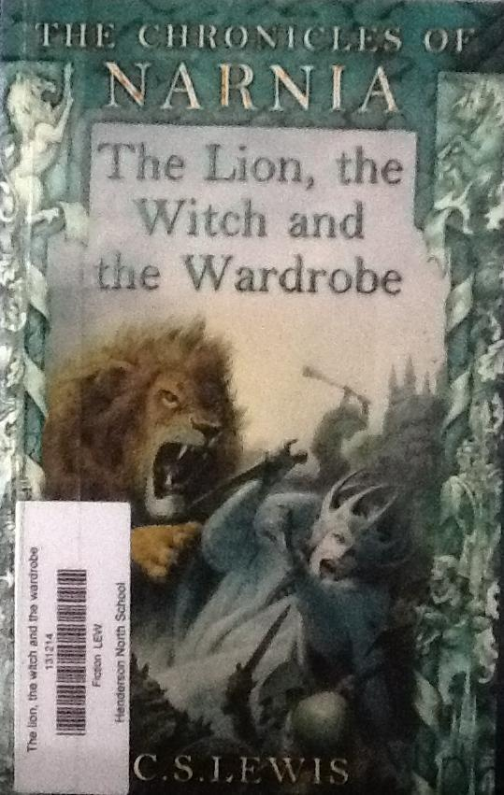
Free Choice
You may choose 12 books from any genre. Yay! Make sure you know which genre they are so you can record that in your notebook.

Slide 19
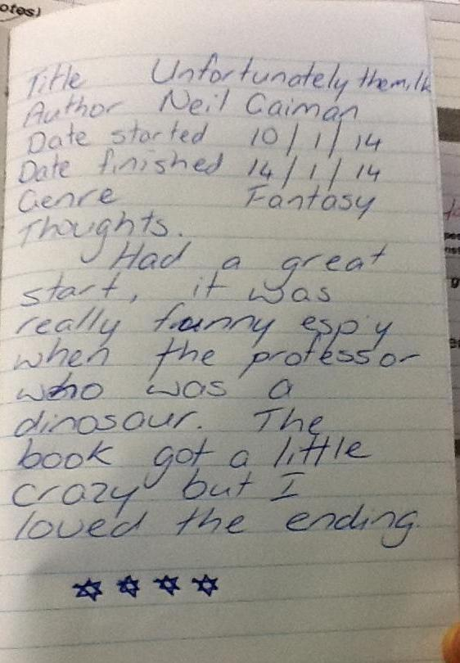
Evidence
We will record all the books
we read including:
Title & Author
Genre
Rating
Date started/finished
Review

